Slide 1
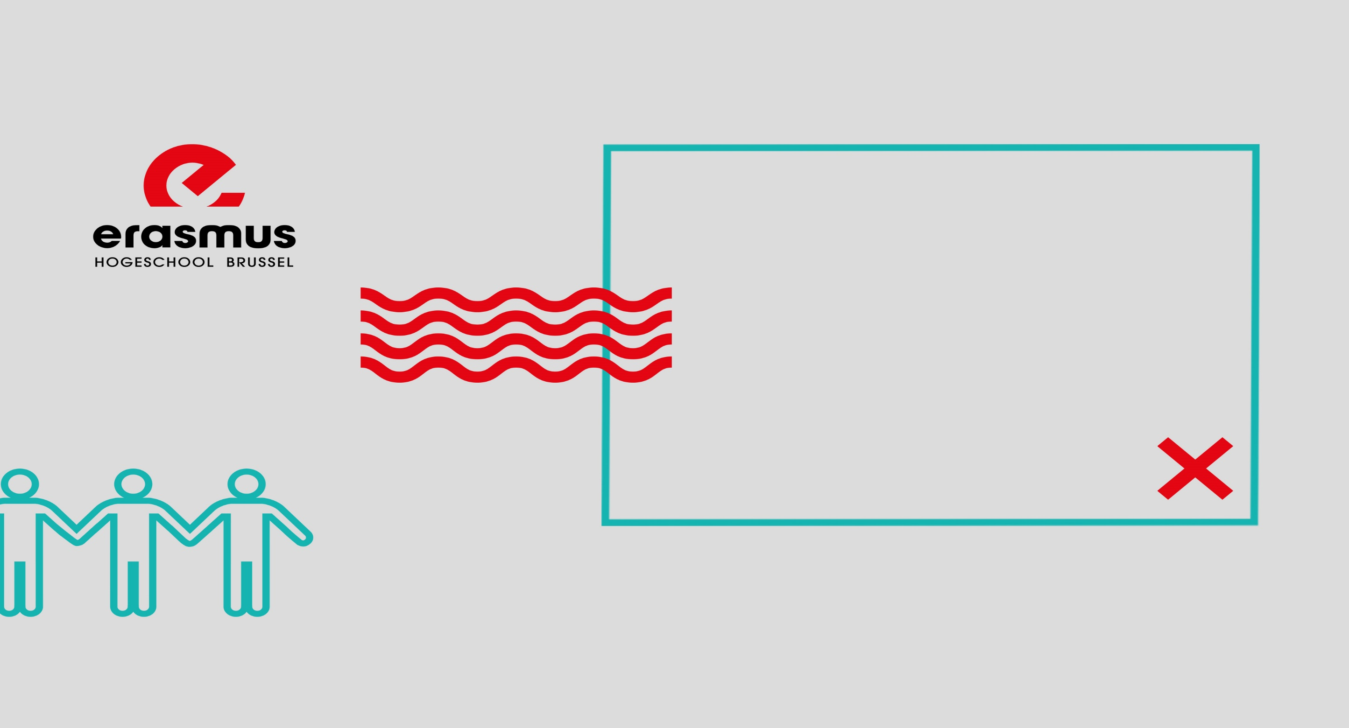
International days @ HdM Stuttgart
Exchange opportunities
with COMMUNICATION
@ EhB Brussels
23 November 2022

Slide 2
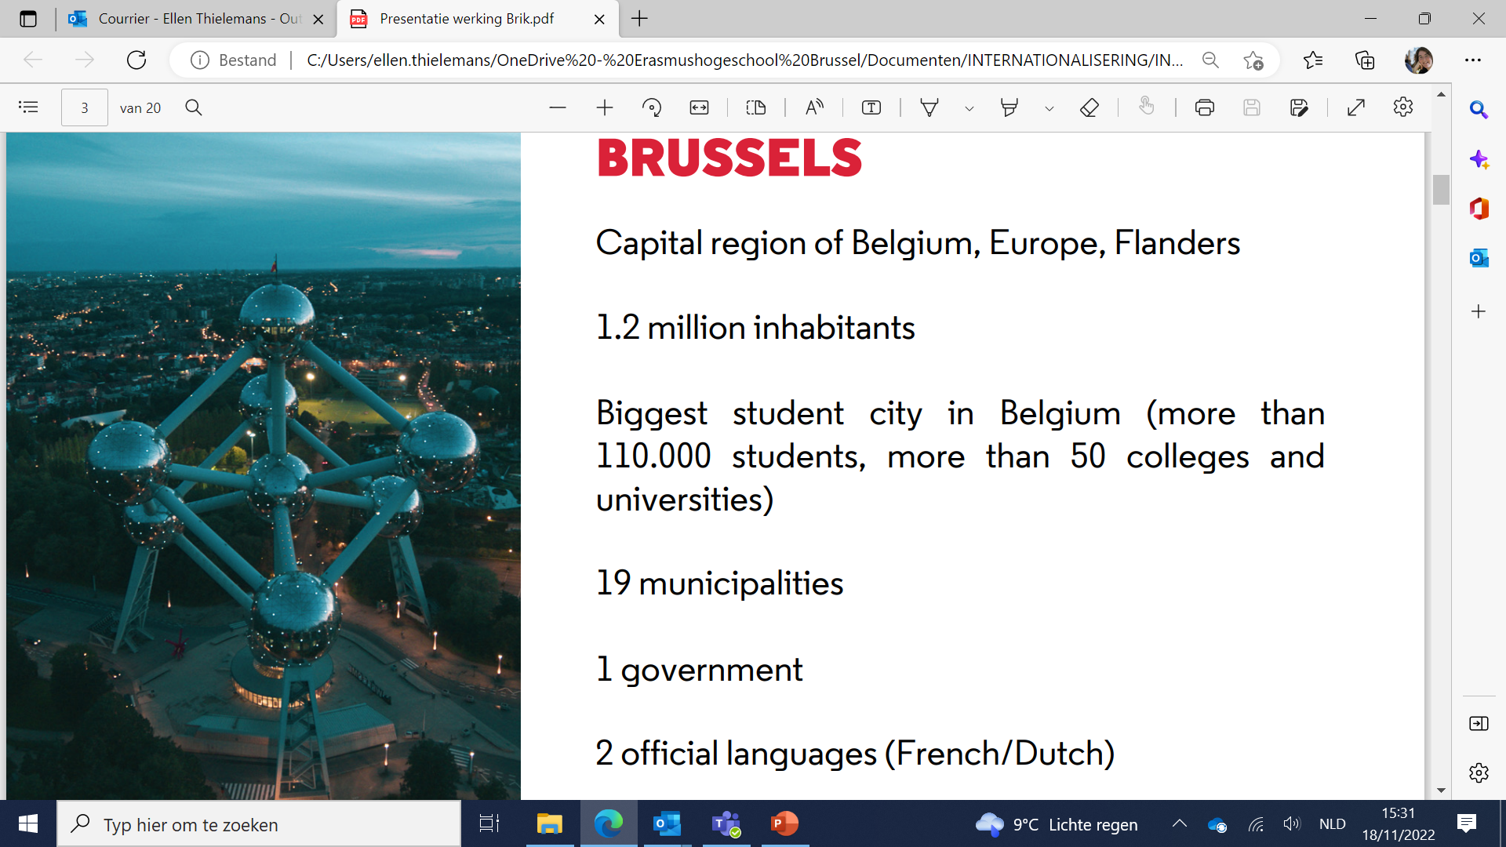
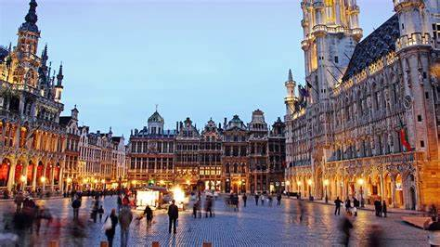
182 nationalities
Notes:
Belgium: The Belgian population is 11 million (compared with 81 million Germans). The population is divided in two main language groups with about 6mio Dutch speakers and 4 mio French speakers (plus 67.000 German speakers living on the German border). Brussels upsets this neat division by being a primarily French-speaking pocket within Dutch-speaking Flemish territory.
Belgium is a bout a quarter of size of England and could fit into France 18 times.
The fact that Brussels is the capital of Belgium is a good thing for the Belgians, because this city’s status as ‘the capital of Europe’ means that people all over the world have at least been able to place Belgium (roughly) on the map.

Slide 3
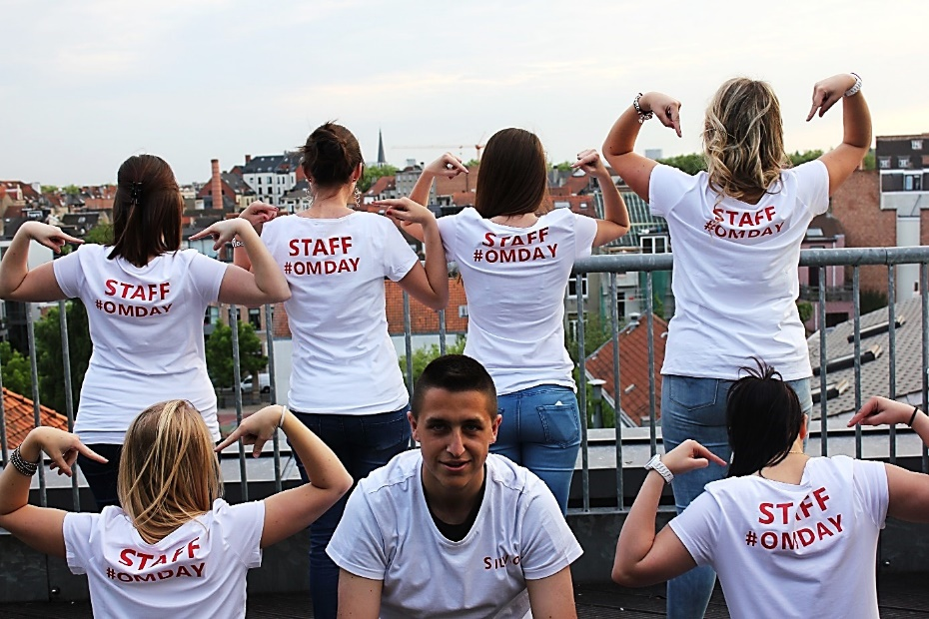
Erasmushogeschool - Facts & figures
Notes:
Studying in Brussels = studying in a global city on a student scale.
The Erasmushogeschool Brussel (EhB) is big because it is small.
Erasmus Brussels University of Applied Sciences & Arts educates students in an open and metropolitan context. We are humanistic, pluralistic, Dutch-speaking and Brussels-based. We offer high-quality and future-proof professional and artistic higher education, in and through continuous synergy with research, art development and services
Here you build solid foundations for a successful professional life. You learn a lot and quickly through practice-driven courses and internships. At EhB, you can get your (sub)degree or master's degree in Arts.

Slide 4
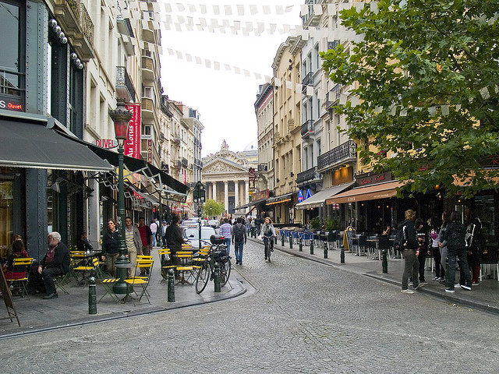
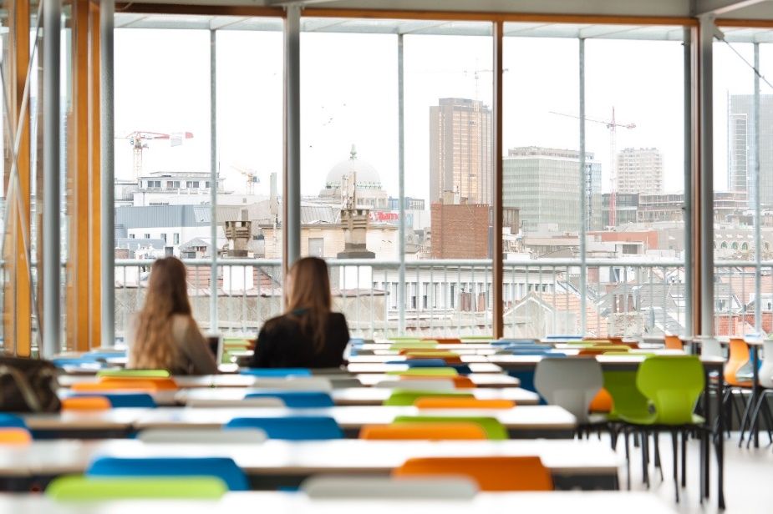
Notes:
= the best campus in the city
Brussels city centre
Flemish quarter
fashion, vintage, design
bars,...

Slide 5
BA COMMUNICATION
multidisciplinary modules
&
more individualized education
&
blended
Coaching approach
Self management
Blended Learning
Room for empowerment
Notes:
Innovative approach - We are moving away from the classic pattern of week-long classes in auditoriums, individual subjects and an intensive study period followed by an exam marathon. Instead, we work with thematic courses with varied and relevant forms of learning, work and assessment.
Integrated/multidisciplinary
We used to teach separate subjects with separate exams: Communication Management, Sociology, Psychology, Current Affairs, Economic and Legal Topics ... However, the reality of communication does not consist of separate subjects, but of a whole in which professional concepts and tools merge with insights in people and the world. Therefore, a programme with thematic modules.
This helps students better see the connections between the knowledge domains and encourages them to take control of their learning process and increases study motivation.
Each thematic module still covers the various disciplines, but organised in such a way that they contribute to an overarching communication theme. Example: in the Brand Communication Module, Consumer Psychology is specifically addressed > Students better see the connection between communication and the other disciplines and see their relevance (how they can contribute to a better comm)
Individualised
Teacher = coach: passionate teachers who inspire young people , help them to discover and develop their talents: this happens not only in the project work, but also in the theory lessons in which knowledge is central.
A coaching approach not by the hand' but with the aim of self-reliance and self-management > preparing for lifelong learning
Safety: providing structure, learning to learn by weekly system = step-by-step, under guidance (via coaching approach: coaching small project groups following up students), falling down and getting up again -> becoming aware of oneself in order to be able to regulate oneself
Self-management of the students: during the training students learn to work independently, but also to steer, manage themselves and guide them to that end: via coaching approach in small coached teams or mixed form of small groups in a class of 40-50 students
Blended learning is an integral part of our approach: well-considered mix of work and learning formats or tools & channels in function of the learning content & goals with the aim of self-management + promoting motivation and learning efficiency
This creates space for empowerment of our super-diverse student body.
For real -> blending with real assignments from the work field
Freedom in structure: at the beginning of each week, there are beacons set steps for students to complete by a certain time, but with room for personal organisation
+ giving students enough options according to their own interests via Elective course, free choice of work placement, choice of assignment AP & choice of team members, choice of client for The Bureau,..

Slide 6
Programme exchange students in Communication = fall semester
multidisciplinary modules:
Communication Tomorrow (6 ECTS)
Corporate Communications (6 ECTS)
Profess. project “the Bureau” (= the agency) (6 ECTS)
+ languages & tools
1. Professional English (3 ECTS)
2. Digital crafts (3 ECTS)
electives
Digital content (3 ECTS)
Cultuur BXL culture (3 ECTS)
Communication case (3 ECTS)
Presentation Skills (3 ECTS)
☺ mixed classroom in 3CM!

Slide 7
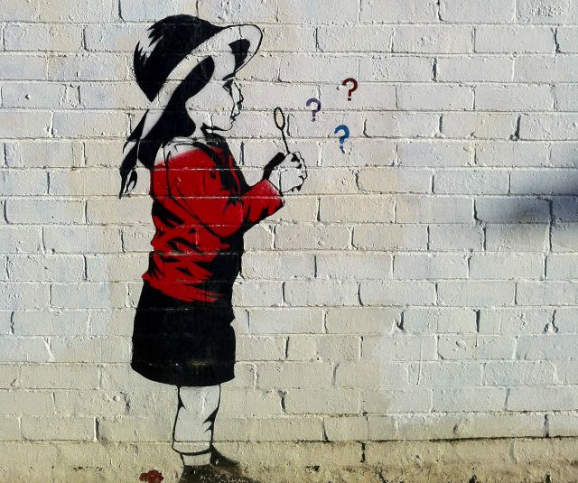
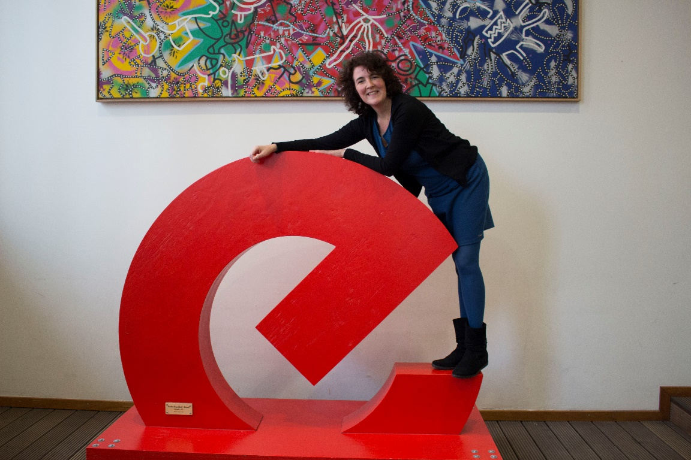
Looking for exchange opportunities?
THANK YOU!
Ellen Thielemans
ellen.thielemans@ehb.be

